Slide 1
Computational Geometry
C.Sc. 562

Slide 2
Prerequisites
Knowledge of algorithm design techniques like Divide & Conquer, Greedy & So on.
Knowledge of analysis techniques such as asymptotic notation.
Knowledge of basis data structures and programming.

Slide 3
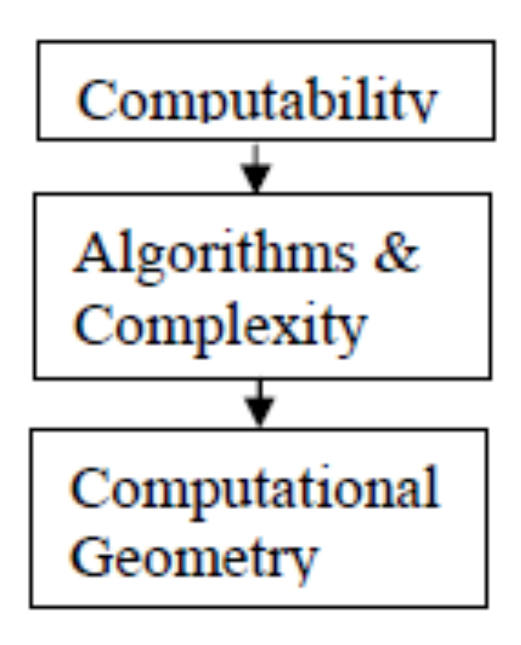
Computational Geometry Evolution
Alan Turing
Donald Knuth, Alfred Aho
Michael Ian Shamos, Franco P. Preparata

Slide 4
Computer Graphics
Include synthesizing the pictures from the given mathematical or geometrical models.
Thus it covers the methods for modeling and rendering the scenes.
It is field of visual computing.

Slide 5
Computational Geometry
Deals with study of algorithms to solve problems stated in terms of geometry.
The geometric problems may be decomposition of polygon into triangles, finding convex hulls, determining intersection of line segments and soon.
It is the study of combinatorics and algorithms for collections of geometric objects, such as points, lines, and planes in some dimension.
The major issues concerned are convexity, proximity, intersection, decomposition and so on.
Shamos’s thesis, which initiated the field of computational geometry.

Slide 6
Computational Geometry Vs. Computer Graphics
Computational geometry and computer graphics both consider geometric phenomena as they relate to computing.
Computational geometry provides a theoretical foundation involving the study of algorithms and data structures for doing geometric computations.
Computer graphics concerns the practical development of the software, hardware, and algorithms necessary to create graphics (i.e., to display geometry) on the computer screen.

Slide 7
Computational Geometry
Combinatorial Computational Geometry:
  Deals with geometric objects as discrete entities.
  The primary goal is to develop efficient algorithms and data structures for solving the problems stated in terms of basic geometrical objects, points, lines, polygons, etc. in general flat surfaces.
Numerical Computational Geometry:
  The core problems are curve & surface modeling and their representations.
  Geometrical objects may be parametric curves as Bezier curve, spline curves.

Slide 8
Computational Geometry
The core problems in computational geometry may be classified in different ways as:
Static Problems
  Some input is given & corresponding output needs to be found. e.g. convex hull, line segment intersection, Voronoi diagram, polygon triangulation, …
  Geometric query problems: Input consists of two parts; the search space and the query part, which varies over the problem instances. The search space is preprocessed so that multiple queries can be answered.
Dynamic problems
  Goal is to find an efficient algorithm for finding a solution repeatedly after each incremental modification of the input data. So involve dynamic data structures.
  Example
    Dynamic range search - (by providing addition or deletion of points)
    Dynamic convex hull - (for dynamically changing set of points)

Slide 9
Computational Geometry
Application Domains
  Computer Graphics
  Rendering and Simulations
  Robotics : Path Planning
  Games: Collision Detection
  GIS, Maps
  CAD/CAM – IC Design, automobile, buildings.
  Pattern recognition
  So on …

